Slide 1

Wireless Networking
Chapter 8
420-A32 - Networks

Slide 2
What is a Wireless Network?
Networks that transmit signals through the air via radio frequency (RF) waves are called wireless networks or WLANs.

Slide 3
The Wireless Spectrum
All wireless signals are carried through the air by electromagnetic waves.
Wireless spectrum is a series of electromagnetic waves used for data and voice communication.
Waves arranged by frequencies, from lowest to highest.
Spectrum spans 9 KHz to 300 GHz
Each type of wireless services is associated with one area (frequency band) of the spectrum.

Slide 4
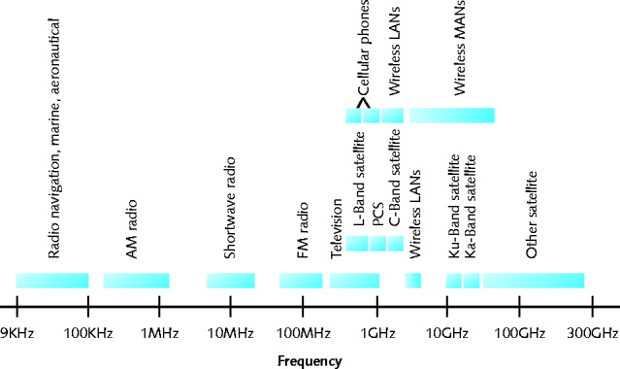
The Wireless Spectrum

Slide 5
Wireless vs Wired Transmission
Similarities between wireless and wired communication:
Use same Layer 3 and higher protocols
Same signal origination - from electrical current, travel along conductor
Differences between wireless and wired
Signal transmission is different because no fixed path through the air.

Slide 6
Wireless Transmission and Reception
Steps involved in wireless transmission/reception:
1) Wireless signals originate from electrical current travelling along a conductor.
2) Signal travels from the transmitter to an antenna, which then emits the signal into the air.
3) Signal propagates through the air until it reaches its destination.
4) At the destination, another antenna accepts the signal, and a receiver converts it back to electrical current.

Slide 7
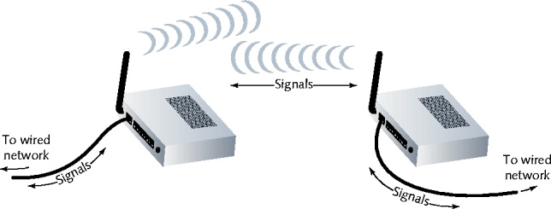
Wireless Transmission and Reception

Slide 8
Antennas
An antenna is used for signal transmission and reception.
The same frequency is required on each antenna, which means they share the same channel.
Each type of wireless service requires an antenna designed specifically for that service.
Radiation pattern = relative strength over three-dimensional area

Slide 9
Antennas
A directional antenna issues wireless signals along a single direction.
Used in a point to point link.
Omnidirectional antenna issues and receives wireless signals with equal strength and clarity in all directions.
Used when many receivers must pick up the signal.
TV and radio stations.
Range = geographical area that an antenna can reach.
Receivers must be in range.

Slide 10
Signal Propagation
Ideally a wireless signal would travel in a straight line from transmitter to receiver.
called LOS (line-of-sight) propagation
However there are obstacles that affect signal travel and the signal must pass through or absorb the obstacle.
Signal problems:
Reflection: bounce signal back to source
Diffraction: splits signal into secondary waves
Scattering: reflection of signal in multiple different directions

Slide 11
Signal Propagation
As a result of these reflection, diffraction and scattering, wireless signals follow a number of different paths to their destination.
Called multipath signals
Multipath advantage:
Better chance of reaching destination
Multipath disadvantage:
Signal delay

Slide 12
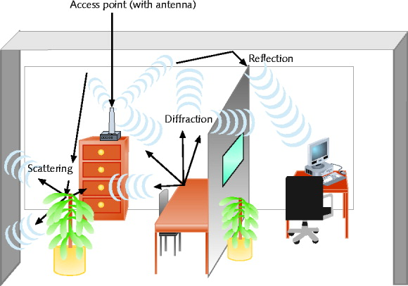
Multipath Signal Propagation

Slide 13
Signal Degradation
When signals run into obstacles, the signal will experience fading as a result of the electromagnetic energy scattered, reflected, diffracted.
Received signal is lower than the transmitted signal’s strength.
Attenuation - signal weakens as it moves away from transmission antenna
Correcting signal attenuation requires a repeater.
Noise (EMI) is biggest problem with signals because the air contains so many electromagnetic waves.

Slide 14
Wireless Spectrum Use
Narrowband
Transmitter concentrates signal energy at single frequency, very small frequency range
Broadband
Relatively wide wireless spectrum band
Higher throughputs than narrowband
Spread-spectrum
Multiple frequencies used to transmit signal
Offers security

Slide 15
Fixed versus Mobile
Each type of wireless communication falls into either
Fixed
Mobile
In fixed systems the location of the transmitter and receiver do not move.
Advantage
No wasted energy issuing signals
More energy used for signal itself
In mobile systems the receiver is located anywhere within transmitter’s range.
Receiver can roam

Slide 16
WLAN Architecture
Ad hoc WLAN
Wireless nodes (stations) transmit directly to each other using wireless NICs.
There is no intervening connectivity device
Poor performance
Many spread out users, obstacles block signals

Slide 17
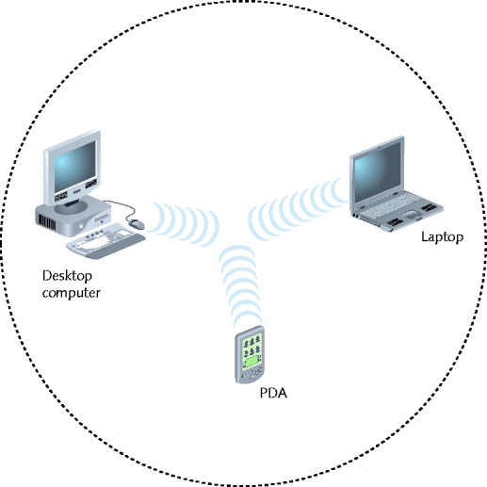
An Ad hoc WLAN

Slide 18
WLAN Architecture
An access point (AP) is a device that accepts wireless signals from multiple nodes and retransmits signals to network.
Base stations, wireless routers, wireless gateways
Infrastructure WLAN
Stations communicate with access point and not directly with each other.
Access point requires sufficient power, strategic placement
WLAN may include several access points
Dependent upon number of stations; max varies: 10-100

Slide 19
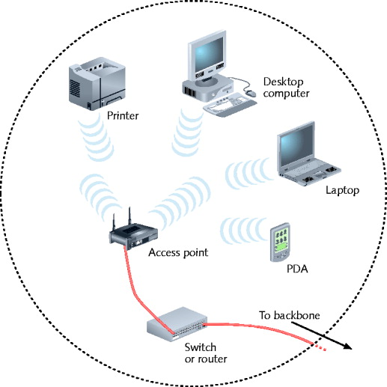
An Infrastructure WLAN

Slide 20
WLAN Architecture
Mobile networking allows roaming wireless nodes
Range dependent upon wireless access method, equipment manufacturer, office environment
Access point range: 300 feet maximum
Can connect two separate LANs
Fixed link, directional antennas between two access points
Allows access points 1000 feet apart
Support for same protocols, operating systems as wired LANs
Ensures compatibility

Slide 21
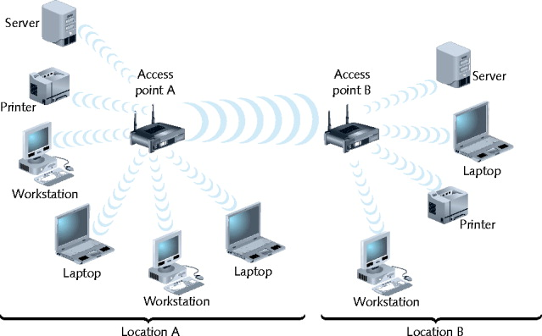
WLAN Interconnection

Slide 22
IEEE 802.11 WLANs
Wireless standards vary by frequency, methods of signal and geographic range.
Wi-Fi (wireless fidelity) standards
802.11b, 802.11a, 802.11g, 802.11n
Share characteristics
Half-duplexing
CSMA/CA access method
frame format

Slide 23
802.11 Access Method
802.11 MAC services
Append 48-bit (6-byte) physical addresses to frame
Identifies source, destination
Same physical addressing scheme as 802.3
Allows easy combination
Wireless devices
Not designed for simultaneous transmit, receive
Cannot quickly detect collisions
Use different access method

Slide 24
802.11 Access Method
CSMA/CA (Carrier Sense Multiple Access with Collision Avoidance)
Minimizes collision potential
Uses ACK packets to verify every transmission
Requires more overhead than 802.3
Real throughput less than theoretical maximum
RTS/CTS (Request to Send/Clear to Send) protocol
Ensure packets not inhibited by other transmissions
Efficient for large transmission packets
Further decreases overall 802.11 efficiency

Slide 25
802.11 Association
Association is a packet exchange between a computer and an access point to gain Internet access.
Scanning
Surveying surroundings for access point
Active scanning transmits special frame called a probe.
Passive scanning listens for special signal called a beacon frame.

Slide 26
802.11 Association
SSID (service set identifier)
Unique character string identifying access point
In beacon frame information
Configured in access point
Better security, easier network management
BSS (basic service set)
Station groups sharing access point
BSSID (basic service set identifier)
Station group identifier

Slide 27
Association
ESS (extended service set)
Access point group connecting same LAN
Share ESSID (extended service set identifier)
Allows roaming
Station moving from one BSS to another without losing connectivity
When several access points are detected:
Select strongest signal, lowest error rate
Poses security risk
Powerful, rogue access point

Slide 28
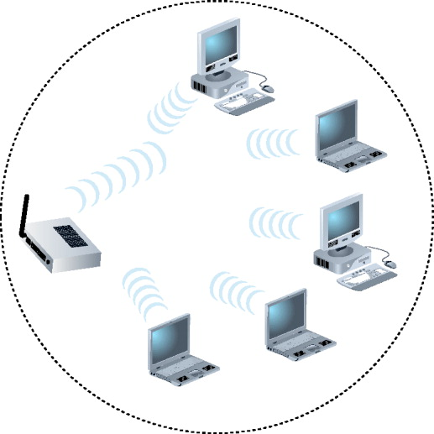
Network with Single BSS

Slide 29
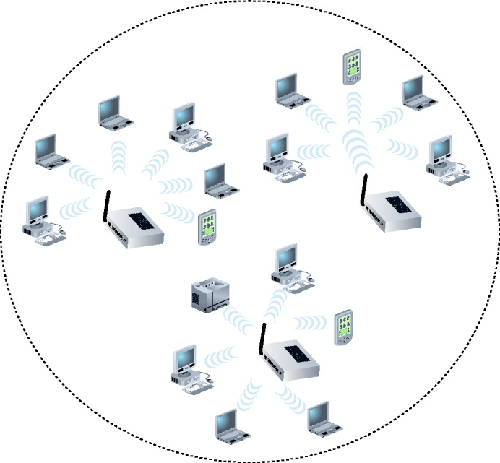
Network with Multiple BSSs Forming an ESS

Slide 30
Association
ESS with several authorized access points
Must allow station association with any access point
While maintaining network connectivity
Reassociation
Mobile user moves from one access point’s range into another’s range
Occurs by simply moving, high error rate
Stations’ scanning feature
Used to automatically balance transmission loads
Between access points

Slide 31
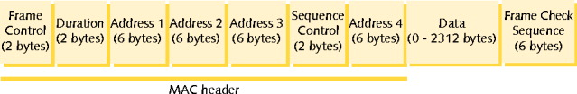
Basic 802.11 Frame
3 Frame types:
Management – used for association and reassociation
i.e. Beacon frames, probe frames
Control – related to medium access and data delivery.
i.e. ACK frames
Data – used to carry data
Frames contain 4 address fields
source address
destination address
transmitter address – refer to the access point
receiver address – refer to the access point

Slide 32
802.11 Standards
802.11b
DSSS (direct-sequence spread spectrum) signaling
Oldest, least expensive, being replaced by 802.11g
802.11a
Released after 802.11b
More expensive, least popular
802.11g
As affordable as 802.11b but provides better throughput
802.11n – Standardized in Sept 2009
Provides much higher effective throughput than others
MIMO (multiple input-multiple output) - Multiple access point antennas may issue signal to one or more receivers

Slide 33
Bluetooth Networks
Ericson’s original goals
Wireless technology compatible with multiple devices
Require little power
Cover short ranges
Bluetooth is a mobile wireless networking standard using FHSS (frequency hopping spread spectrum) RF signaling.
2.4-GHz band.
Used by home networks.

Slide 34
Bluetooth Networks
Version 1.1
Effective throughput: 723 Kbps
10 meter node difference
Designed for PANs (personal area networks)
Version 2.0 (2004)
Different encoding schemes
2.1-Mbps throughput
30 meters node difference
Usage: cellular telephones, phone headsets, computer peripherals, PDAs

Slide 35
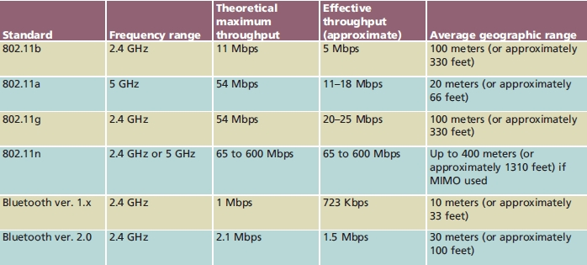
Summary of WLAN Standards

Slide 36
Implementing a WLAN
Designing a small WLAN
Home, small office
Formation of larger, enterprise-wide WANs
Installing and configuring access points and clients
Implementation pitfalls
Avoidance
Material applies to 802.11b and 802.11g
Most popular

Slide 37
Designing a Smaller WLAN
Most home and small office WLANs depend on a single access point.
Combine with switching, routing functions
Connects wireless clients to LAN
Acts as Internet gateway
Access point WLAN placement considerations
Should be centrally located to provide reliable wireless service at any location.
Obstacles
Type, number between access point and clients

Slide 38
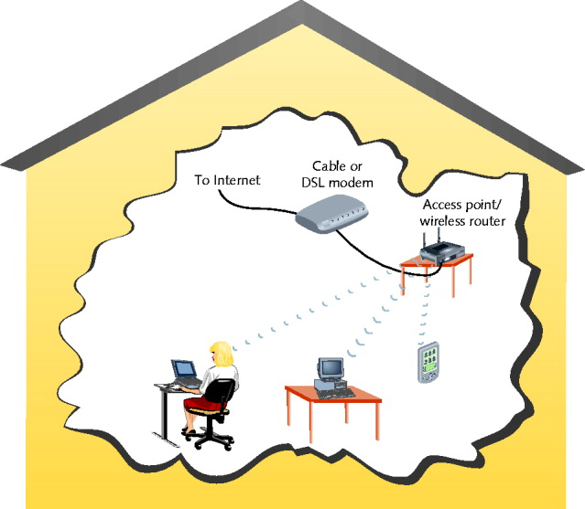
Home or Small Office WLAN

Slide 39
Designing a Larger WLAN
Larger WLANs
Need to determine the appropriate number of access points.
Systematic approach to access point placement
Site survey
Assesses client requirements, facility characteristics, coverage areas
Determines access point arrangement ensuring reliable wireless connectivity within given area.
Proposes access point testing
Testing wireless access from farthest corners

Slide 40
Designing a Larger WLAN
Install access points
Must belong to same ESS, share ESSID
Enterprise-wide WLAN design considerations
How wireless LAN portions will integrate with wired portions

Slide 41
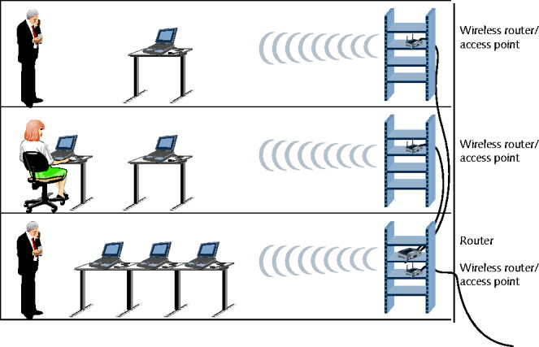
Enterprise-wide WLAN

Slide 42
Configuring Wireless Clients
Configuration varies from one client type to another
Windows XP client WLAN configuration
Use graphical interface
Linux clients wireless interface configuration
Use graphical interface
iwconfig command-line function
View, set wireless interface parameters
Should change SSID and administrator password.

Slide 43
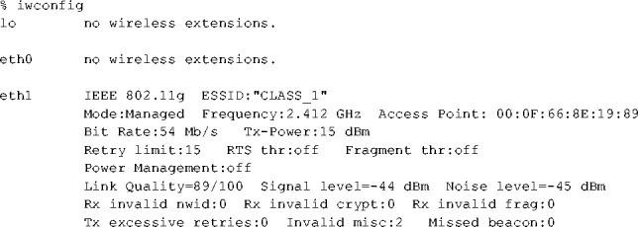
Output from iwconfig command

Slide 44
Avoiding Pitfalls
Access point versus client configurations
SSID mismatch
Incorrect encryption
Incorrect channel, frequency
Standard mismatch (802.11 a/b/g/n)
Incorrect antenna placement
Verify client within 330 feet
Interference
Check for EMI sources

Slide 45
Wireless WANs and Internet Access
Wireless broadband
Latest wireless WAN technologies
Specifically designed for:
High-throughput, long-distance digital data exchange

Slide 46
802.11 Internet Access
Access points: 802.11b or 802.11g access methods
Hot spots
Places with publicly available wireless Internet access
Free or subscription
Hot spot subscription Internet access
Log on via Web page
Client software managing client’s connection
Network log on, secure data exchange
Added security: accept connection based on MAC address
Accept user’s connection based on MAC address

Slide 47
802.16 (WiMAX) Internet Access
WiMAX (Worldwide Interoperability for Microwave Access)
Improved mobility, QoS characteristics
Digital voice signals, mobile phone users
Functions in 2 and 66 GHz range
Licensed, nonlicensed frequencies
Line-of-sight paths between antennas
Throughput potential maximized
Non-line-of-sight paths
Exchange signals with multiple stations at once

Slide 48
802.16 (WiMAX) Internet Access
Two distinct advantages over Wi-Fi
Much greater throughput (70 Mbps)
Much farther range (30 miles)
Appropriate for MANs and WANs
Highest throughput achieved over shortest distances between transceivers
Possible uses
Alternative to DSL, broadband cable
Well suited to rural users
Internet access to mobile computerized devices
Residential homes

Slide 49
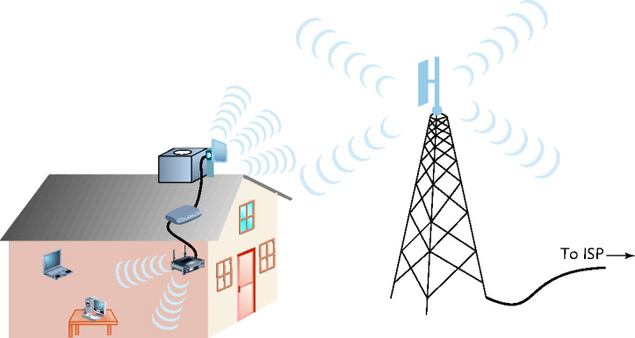
WiMAX Residential Service

Slide 50
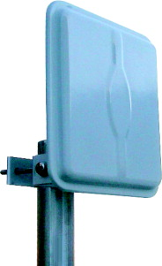
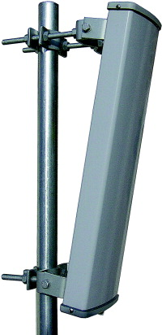
WiMAX Antenna
WiMAX residential antenna
WiMAX service provider’s antenna

Slide 51
802.16 (WiMAX) Internet Access
Metropolitan area installation
Home antenna, connectivity device eliminated
WiMAX MANs
Extensive connectivity
Download data rates faster than home broadband connection
Shared service
Apportioned bandwidth
Drawback
Expensive

Slide 52
Satellite Internet Access
Used to deliver:
Digital television and radio signals
Voice and video signals
Cellular and paging signals
Provides homes and businesses with Internet access

Slide 53
Satellite Orbits
Geosynchronous orbit
Satellites orbit the Earth at the same rate as the Earth turns
Downlink
Satellite transponder transmits signal to Earth-based receiver
Typical satellite
24 to 32 transponders
Unique downlink frequencies
LEO (low Earth orbiting) satellites
Orbit Earth with altitude 100 miles to 1240 miles
Not positioned over equator

Slide 54
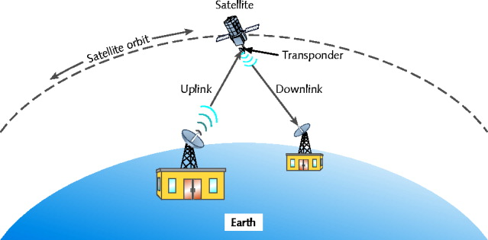
Satellite Communication

Slide 55
Satellite Orbits
MEO (medium Earth orbiting) satellites
Orbit Earth 6000 to 12,000 miles above surface
Not positioned over equator
Latitude between equator and poles
Advantage
Cover larger Earth surface area than LEO satellites
Less power, less signal delay than GEO satellites
Geosynchronous orbiting satellites most popular for satellite Internet access

Slide 56
Satellite Internet Services
Subscriber
Small satellite dish antenna, receiver
Exchanges signals with provider’s satellite network
Satellite Internet access service
Dial return arrangement (asymmetrical)
Receives Internet data via downlink transmission
Sends data to satellite via analog modem connection
Satellite return arrangement (symmetrical)
Send, receive data to and from Internet using satellite uplink and downlink

Slide 57
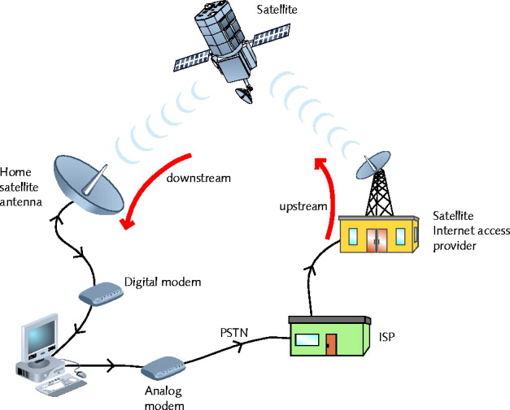
Dial Return Satellite Internet Service

